Slide 1
3
Some Key Ingredients for Inferential Statistics

Slide 2
Describing a Score
Knowing one score tells little about how it relates to the whole distribution of scores
Comparing a score to the mean of a distribution does indicate whether a score is above or below average

Slide 3
Relating a Score to the Mean
Knowing the standard deviation of a distribution indicates how much above or below average a score is in relation to the spread of scores in the distribution

Slide 4
Z Scores
Why use them?
  Ordinary score transformed so that it better describes a scores location on a distribution
  Apples to oranges

Slide 5
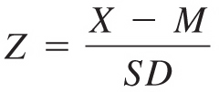
Z Scores -1
Number of standard deviations a score is above or below the mean
Formula to change a raw score to a Z score:

Slide 6

Z Scores -2
Formula to change a Z score to a raw score:
Distribution of Z scores
  Mean = 0
  Standard deviation = 1

Slide 7
Two Properties of Z Scores
The sum of a set of z-scores is always zero because the mean has been subtracted from each score, and following the definition of the mean as a balancing point, the sum and average of deviation scores must be zero

Slide 8
Two Properties of Z Scores
The SD of a set of standardized scores is always 1 because the deviation scores have been divided by the standard deviation

Slide 9
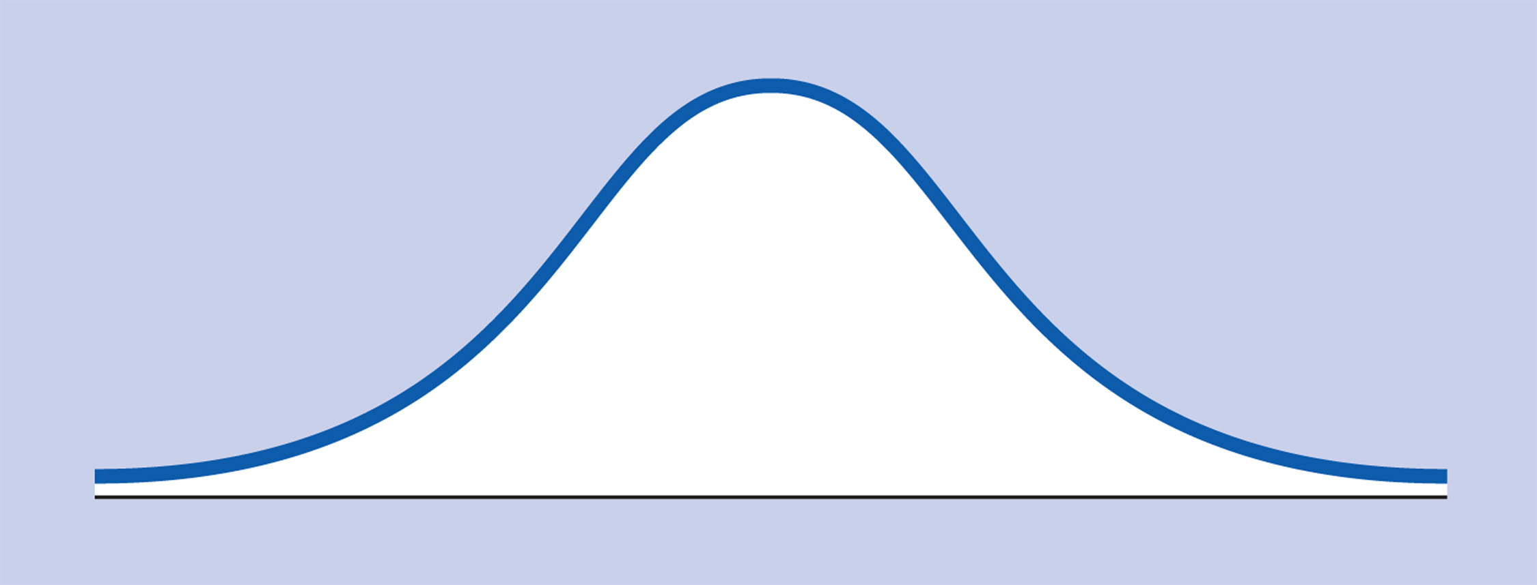
The Normal Distribution -1
Normal curve

Slide 10
Normal Distribution Characteristics
Symmetrical
Unimodal
Most scores fall near center, fewer at extremes

Slide 11
Normal Curve
Distribution – symmetrical and unimodal
Properties
  Because it’s symmetrical, know number of scores at each point on the curve
  Mean = 50% point

Slide 12
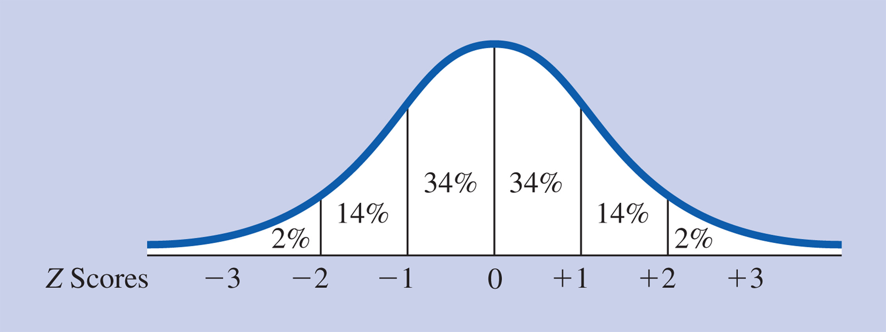
Percentage of Areas under the Normal Distribution
Normal curve and percentage of scores between the mean and 1 and 2 standard deviations from the mean

Slide 13
The Normal Distribution and Z Scores
The normal curve table and Z scores
  Shows the precise percentage of scores between the mean (Z score of 0) and any other Z score
  Table also includes the precise percentage of scores in the tail of the distribution for any Z score
  Table lists positive Z scores

Slide 14
Types of Problems
Find Z (given X, M, SD)
Find X (given Z, M, SD)
Find the percent (given Z)
Find the percent (given X, M, SD)
Find Z for a given percent
Find X for a given percent (given M, SD)

Slide 15
Suppose that the mean score on a creativity test is 16 and the standard deviation is 4. You are told that the distribution is normal. Using the approximations for normal curves, how many people would get a score between 12 and 20?

Slide 16
Samples and Populations
Population
Sample
Methods of sampling
  Random selection
  Haphazard selection

Slide 17
Sample and Population
Population – entire group of people in which a researcher intends the results of study to apply
  Larger group to which inferences are made

Slide 18
Sample and Population
Sample – scores of a particular group of people studied
Why sample?
  Study people in general
  Too many people to study all population, $$, time consuming

Slide 19
Population Parameters
Actual value of the mean, standard deviation
  Not actually known
  Estimated based on information in samples

Slide 20
Sample Statistics
Descriptive statistics, such as mean or standard deviation, figured from the group of people studied.

Slide 21
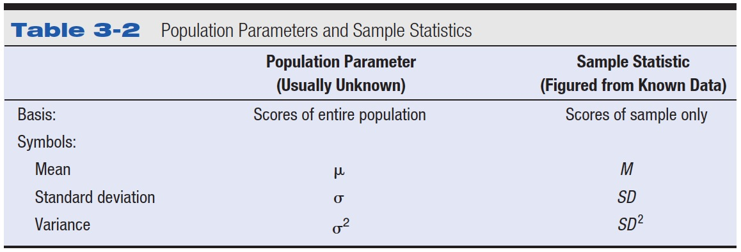
Table 3-2 Population Parameters and Sample Statistics

Slide 22
Sampling Methods
Random sampling – methods for selecting a sample that uses truly random procedures
  Everyone has an equal chance of being selected

Slide 23
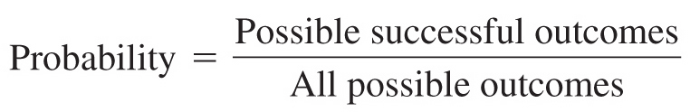
Probability
Probability
  Expected relative frequency of a particular outcome
Outcome
  The result of an experiment

Slide 24
Probability
Long run relative frequency interpretation of probability – understanding of probability as the proportion of a particular outcome that you would get in the experiment were repeated many times

Slide 25
Probability
Subjective interpretation of probability – way of understanding probability as the degree of one’s certainty that a particular outcome will occur

Slide 26
Probability
Range of probabilities
  Proportion: from 0 to 1
  Percentages: from 0% to 100%
Probabilities as symbols
  p
  p < .05
Probability and the normal distribution
  Normal distribution as a probability distribution

Slide 27
Suppose that you have a fish tank full of tropical salt-water fish and you need to know the exact salt content of the water. To test it, suppose you take a cup and scoop some of the water out. In statistical language, the scoop of water is a

Slide 28
Imagine that you role a twelve-sided die. If you role the die once, the probability that you will role a 5, 6, or 7 is

Slide 29
Examples
A statistics student wants to compare his final exam score to his friend's final exam score from last year; however, the two exams were scored on different scales. Remembering what he learned about the advantages of Z scores, he asks his friend for the mean and standard deviation of her class on the exam, as well as her final exam score. Here is the information
Our student Final exam score = 85; Class M = 70; SD = 10.
His friend Final exam score = 45; Class M = 35; SD = 5.

Slide 30
Examples
If the mean score on a stress scale is 5, the standard deviation is 2, and the distribution is normal, the percentage of people who would obtain scores between 5 and 9 is

Slide 31
Examples
Using a normal curve table, if a person received a test score that is in the top 32% of all test scores, the person's Z score must be at least

Slide 32
Examples
A clinical psychologist gave a standard test of symptoms of three different behavioral disorders to a new client. On the scale that measured Disorder F, the client's score was 62 (general public M = 60, SD = 8). On the scale that measured Disorder H, the client's score was 34 (general public M = 32, SD = .5). Finally, on the scale that measured Disorder K, the client's score was 89 (general public M = 83, SD = 12).
a. For which disorder or disorders did the client indicate a substantially higher number of symptoms than the general public?

